Slide 1


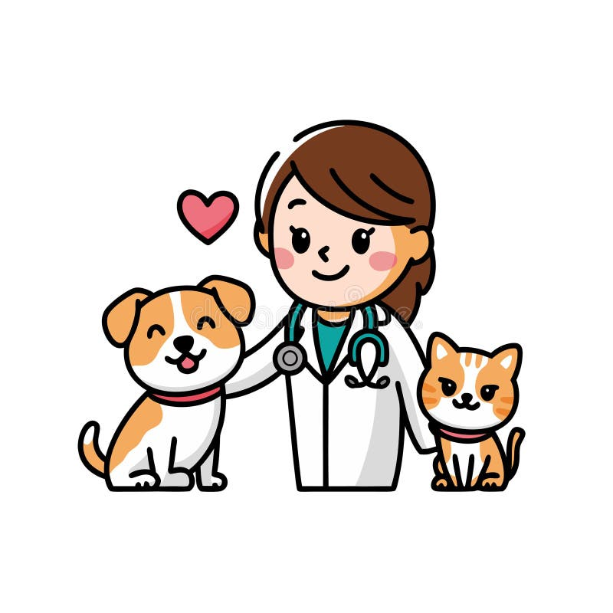

PETDOC
Smart Veterinary Care System with AI based disease detection
CSE 299
Section 04
Group 05
Group 05 | Rishat Bin Sultan, Fariha Islam, Nafia Haque Muskan, MD Tamim Hasan

Slide 2
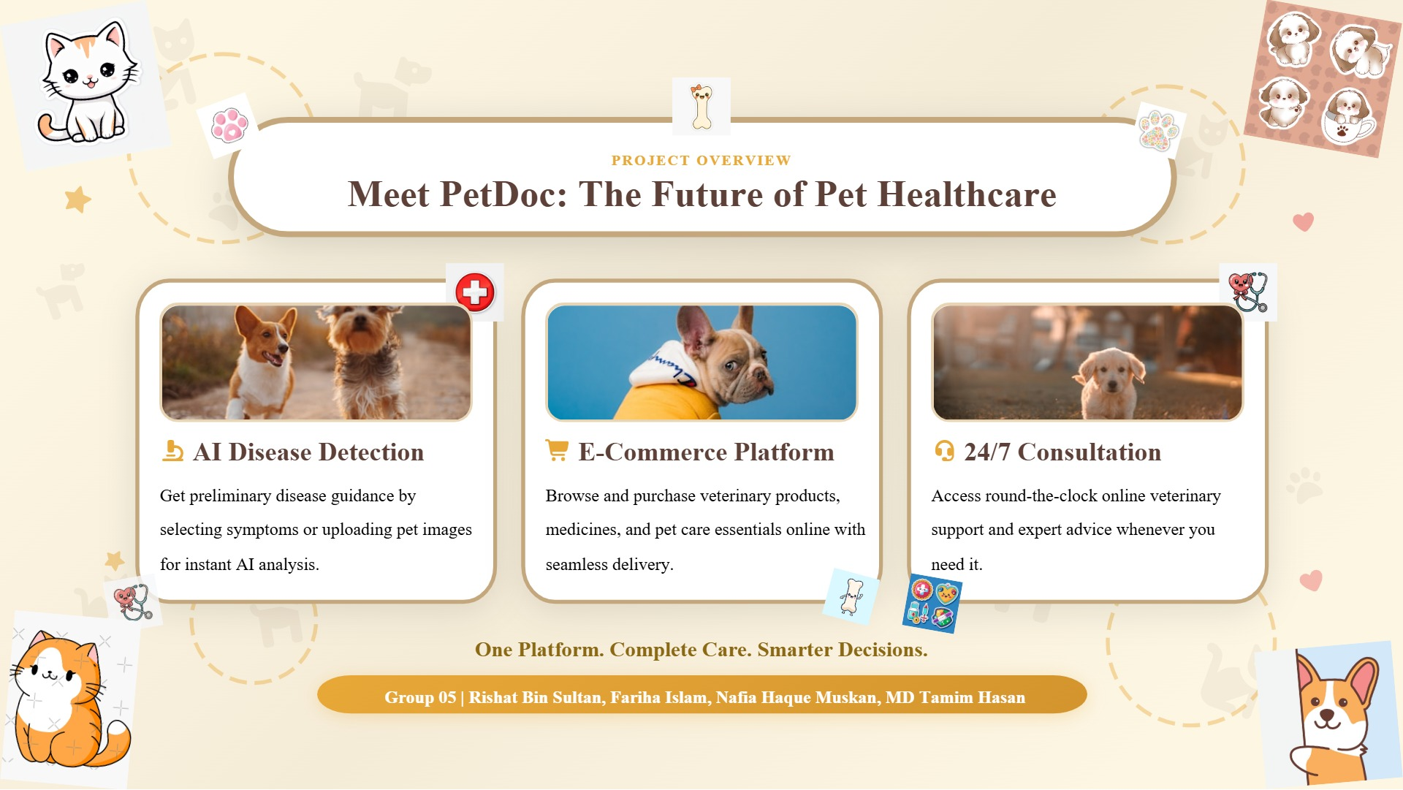

Slide 3


What We Built This Week
Data Collection
ML Model Training
Gathered comprehensive pet symptom datasets and prepared training data for our ML model
Trained our initial disease detection model in Google Colab with optimized algorithms
Django Integration
AI Assistant
Successfully integrated the trained ML model into our Django backend for real-time predictions
Implemented Gemini API to power our dynamic Smart Vet Assistant with intelligent responses
Major milestone: We brought the "AI" into Smart Veterinary System!
Group 05 | Rishat Bin Sultan, Fariha Islam, Nafia Haque Muskan, MD Tamim Hasan

Slide 4
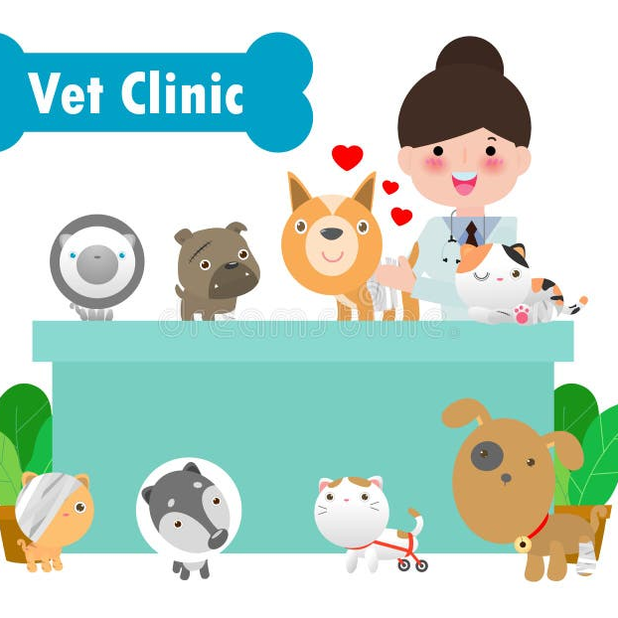
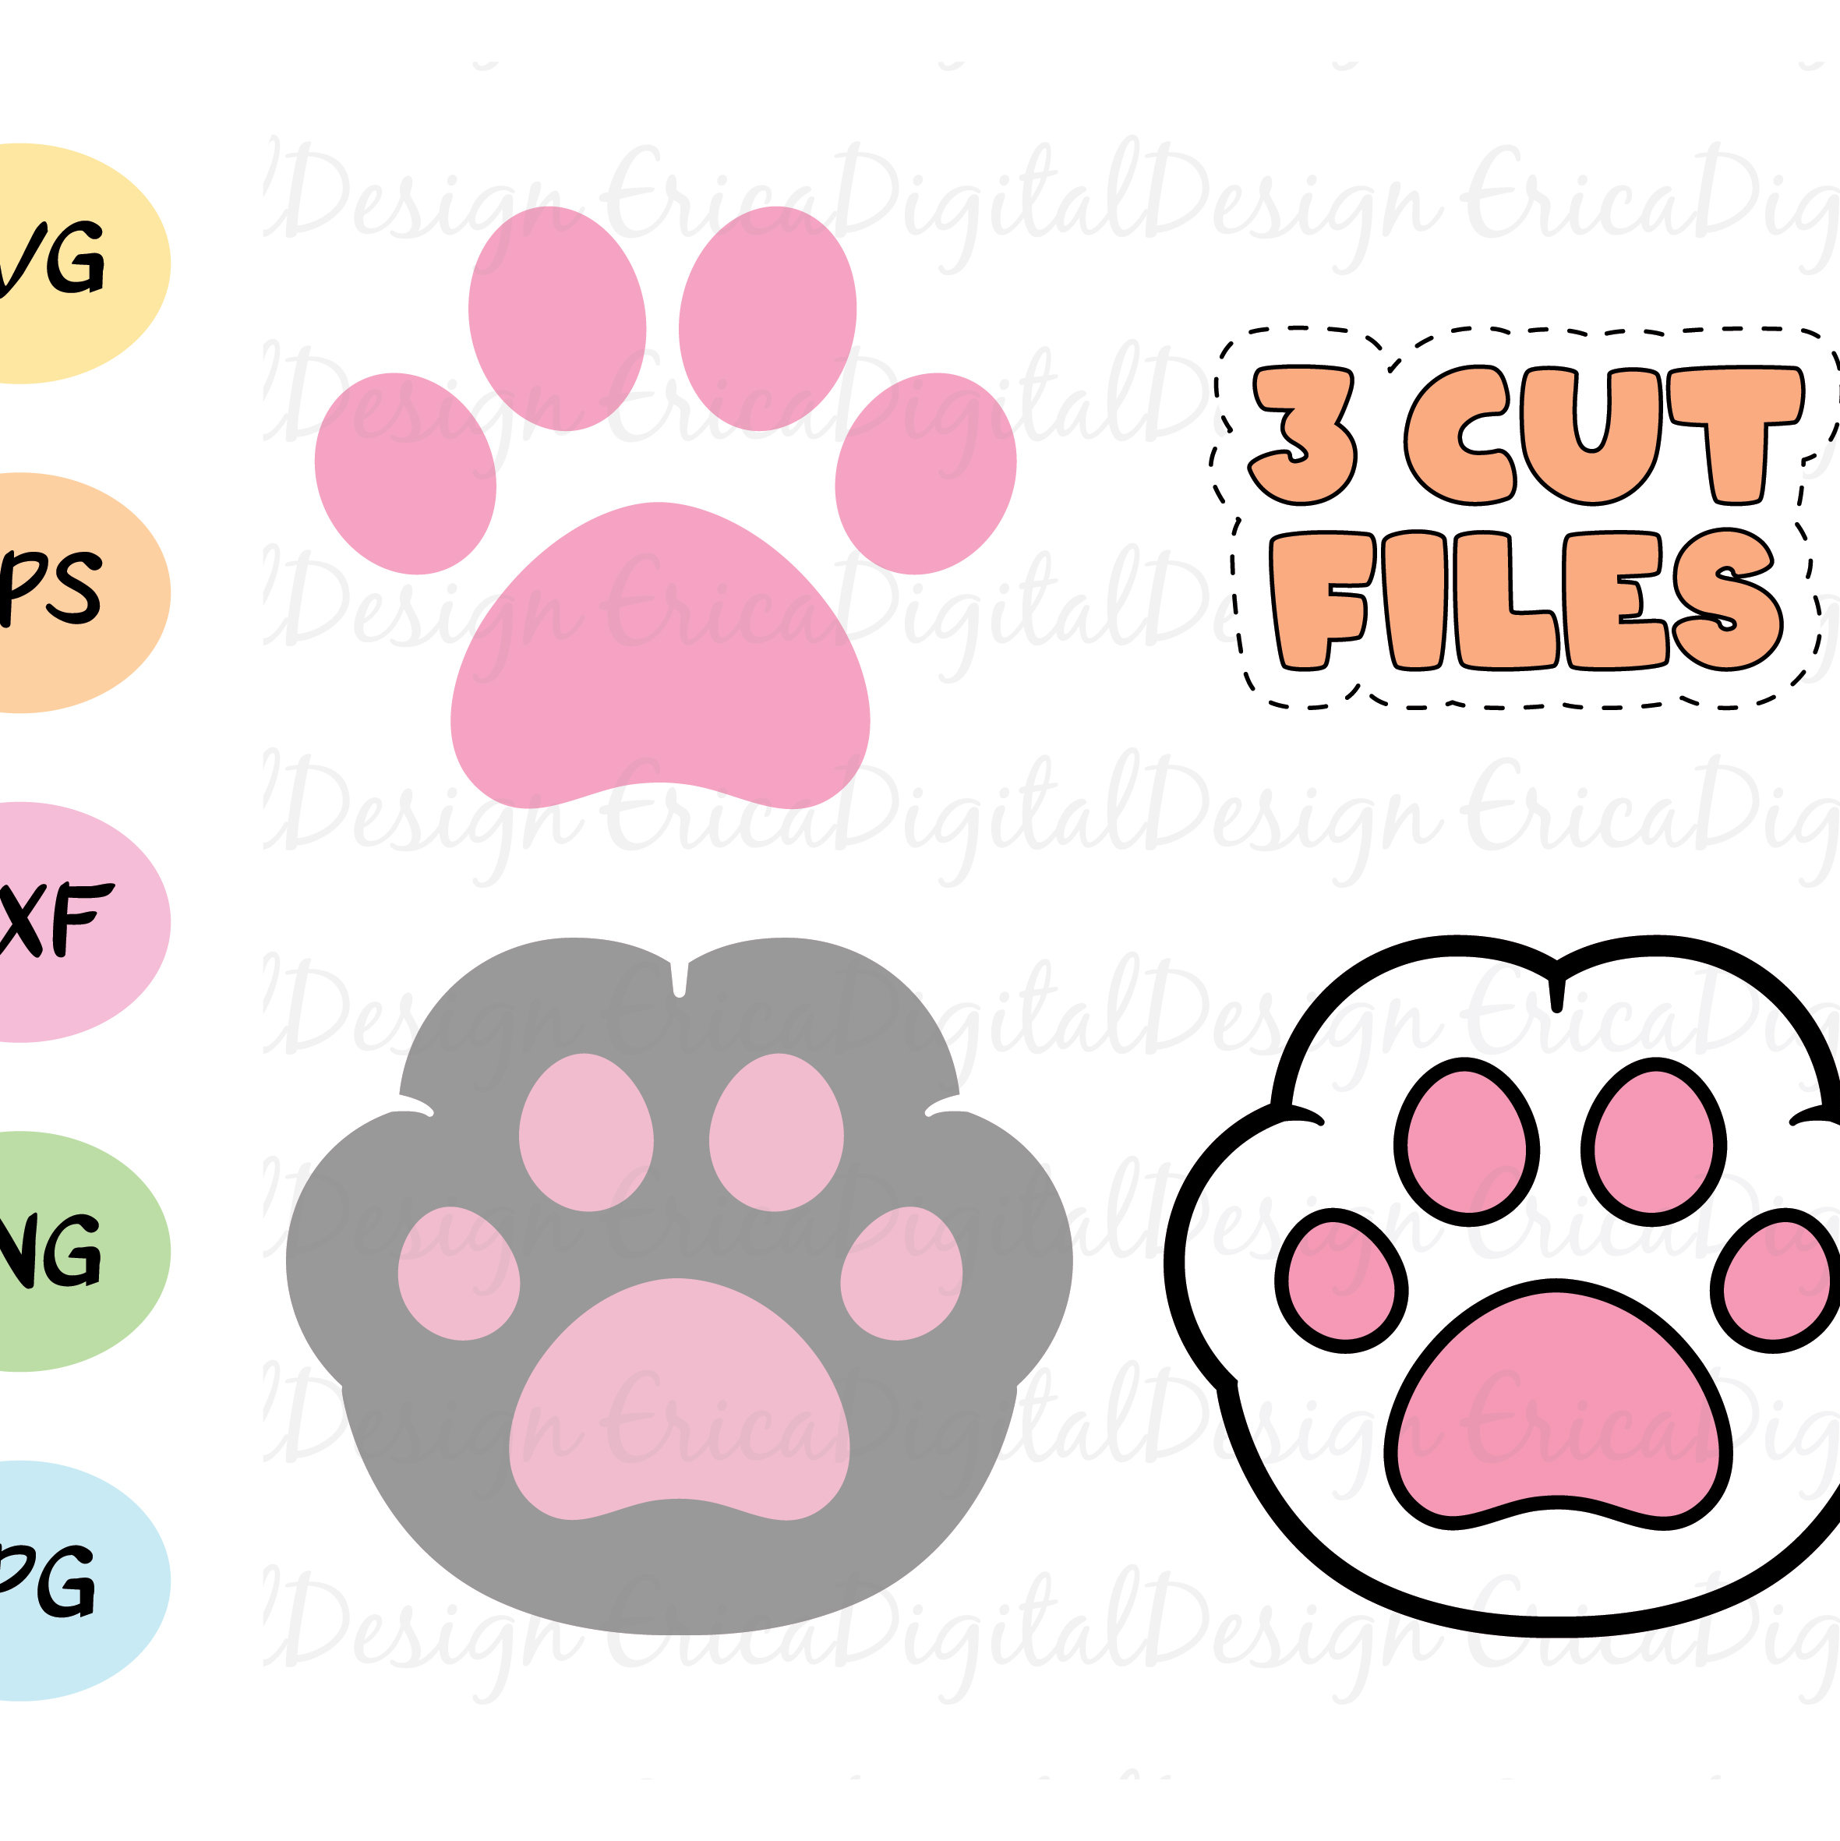
Our Progress at a Glance
Completed Task | Team Member
Data collection, dataset preparation & ML model training in Colab | Nafia Haque Muskan
Integrated Gemini API for AI assistant functionality | Rishat Bin Sultan
Implemented trained ML model in Django backend | Fariha Islam
Smoothed AI assistant frontend for seamless UX | MD Tamim Hasan
Equal task distribution
Great teamwork!
Group 05 | Rishat Bin Sultan, Fariha Islam, Nafia Haque Muskan, MD Tamim Hasan

Slide 5
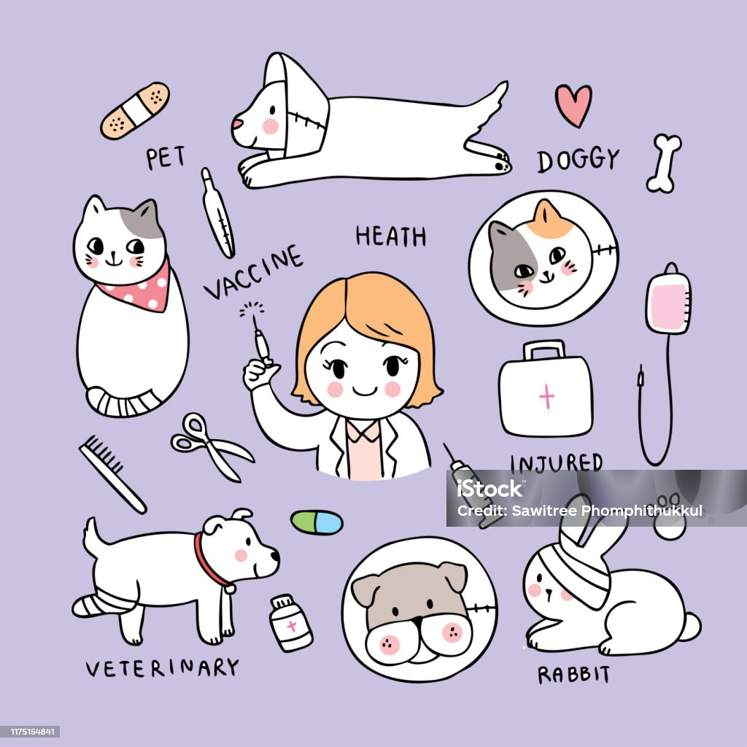
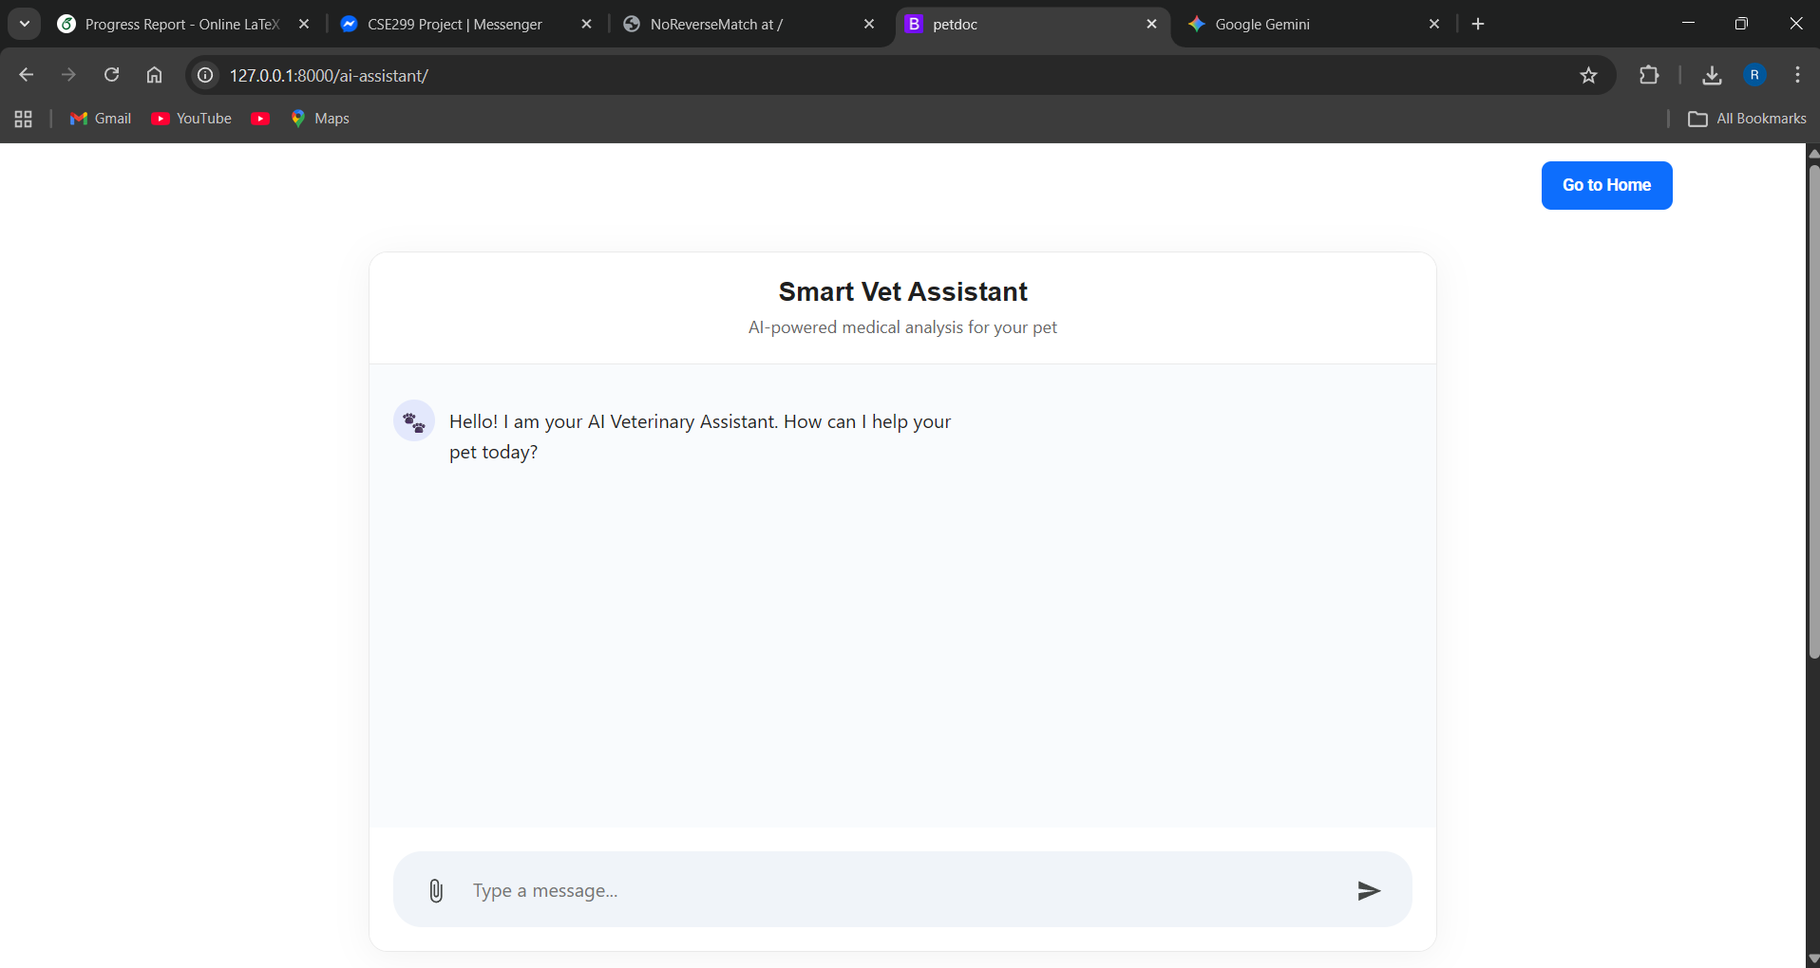
Meet Your AI Vet Assistant
Smart Vet Assistant - Welcome Screen
Friendly Interface
Warm greeting message welcomes users: "Hello! I am your AI Veterinary Assistant. How can I help your pet today?"
Key Features
Chat-based interaction
Powered by Gemini API
Pet-focused design
Group 05 | Rishat Bin Sultan, Fariha Islam, Nafia Haque Muskan, MD Tamim Hasan

Slide 6
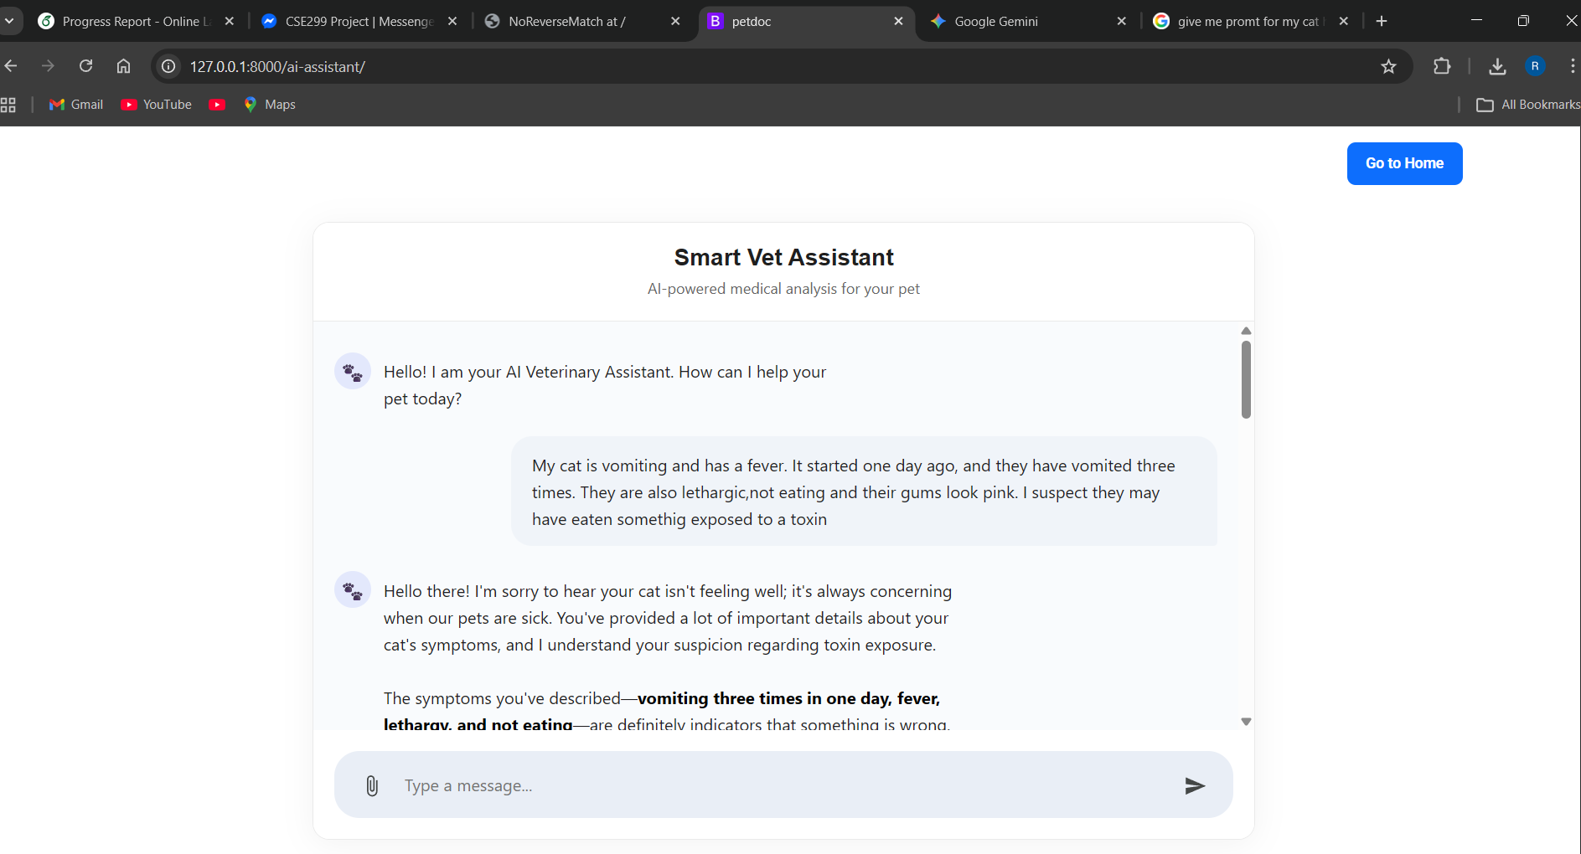
How Users Interact
User Prompt Example
User Input
User describes their pet's symptoms in natural language:
"My cat is vomiting and has a fever. It started one day ago..."
Symptoms Detected
Vomiting (3 times)
Fever
Lethargy
Not eating
Pink gums
Group 05 | Rishat Bin Sultan, Fariha Islam, Nafia Haque Muskan, MD Tamim Hasan

Slide 7
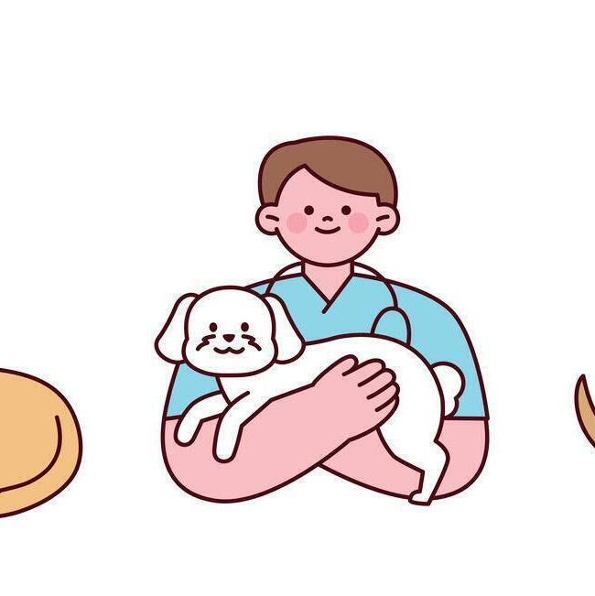
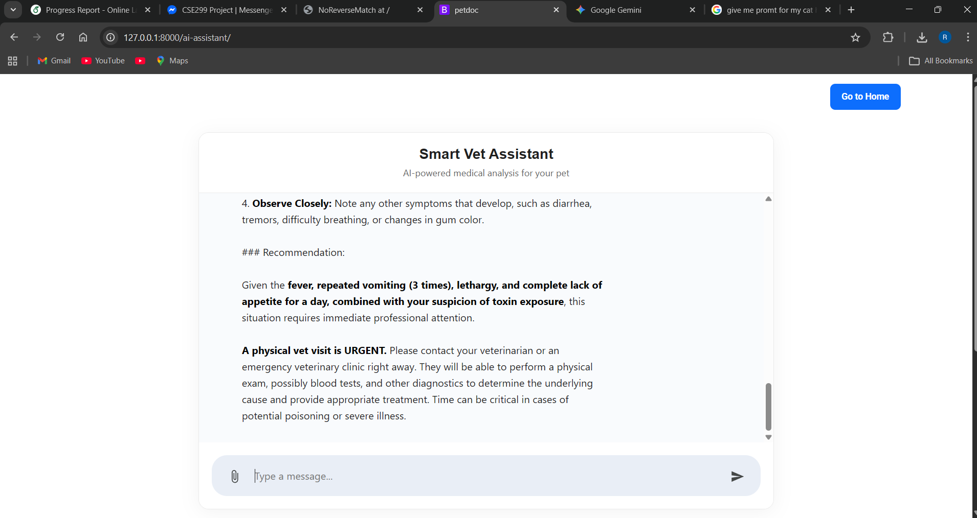
Smart AI Response
AI Assistant Response
Analysis Quality
Empathetic tone & acknowledgment
Detailed symptom breakdown
Clear observation guidelines
Urgent Recommendation
"A physical vet visit is URGENT"
AI clearly states when professional help is needed!
Group 05 | Rishat Bin Sultan, Fariha Islam, Nafia Haque Muskan, MD Tamim Hasan

Slide 8
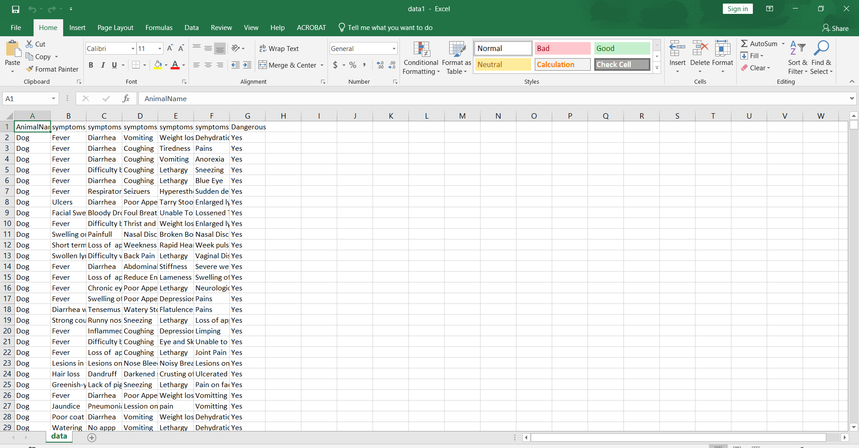
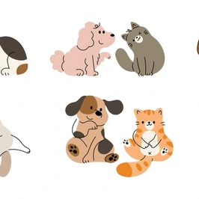
Training Model Dataset
Dataset Details
Animal symptoms data for dogs
Multiple symptom columns
Dangerous condition labels
Key Features
1
Symptom coverage
2
Structured for ML training
3
Ready for model optimization
Group 05 | Rishat Bin Sultan, Fariha Islam, Nafia Haque Muskan, MD Tamim Hasan

Slide 9
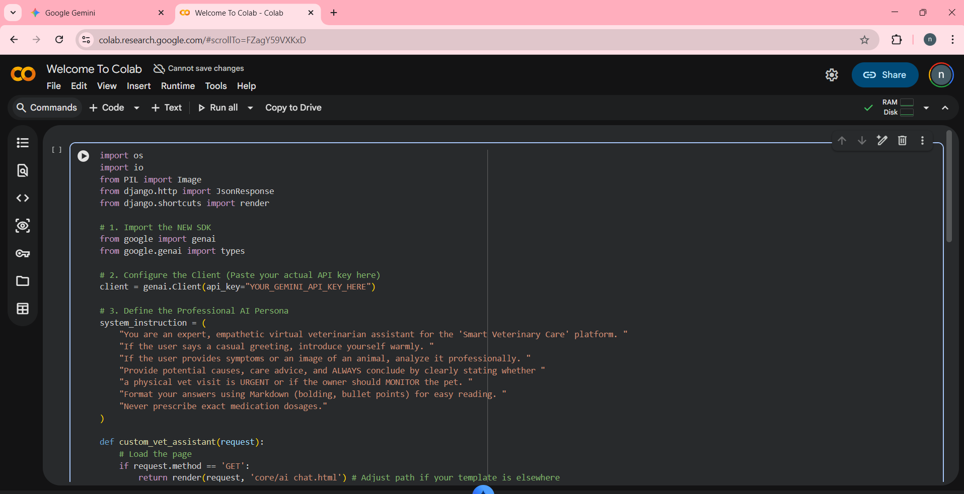
Behind the Scenes: Code
Google Colab Implementation
Key Components
1
Google Gemini SDK import
2
API client configuration
3
Professional AI persona setup
4
Django view function
AI Persona Instructions
✓ Expert, empathetic vet assistant
✓ Warm greetings & professional analysis
✓ Clear URGENT/MONITOR conclusions
✓ Never prescribe exact dosages
Group 05 | Rishat Bin Sultan, Fariha Islam, Nafia Haque Muskan, MD Tamim Hasan

Slide 10
Challenges We Faced
Model Export
API Latency
UI Updates
Exporting trained model from Google Colab and ensuring compatibility with local Django environment
Managing asynchronous requests and handling latency when calling the external Gemini API
Dynamically updating frontend UI to display real-time AI responses without breaking UX
SOLVED ✓
SOLVED ✓
SOLVED ✓
We turned challenges into learning opportunities!
Group 05 | Rishat Bin Sultan, Fariha Islam, Nafia Haque Muskan, MD Tamim Hasan

Slide 11
Smart Decisions Made
Dual AI Architecture
Feature Lock
Decided to lock further feature development to dedicate all remaining time to refining AI models and system stability.
We decided to use Gemini API as a supplementary intelligent layer to support our primary custom-trained disease detection model.
Custom ML Model
Gemini API
Primary detection
Supplementary layer
Focus Strategy
Prioritizing quality over quantity - ensuring our AI features work flawlessly before adding more.
Group 05 | Rishat Bin Sultan, Fariha Islam, Nafia Haque Muskan, MD Tamim Hasan

Slide 12
What's Next?
System Testing
Model Optimization
Conduct comprehensive testing across all modules to identify and resolve existing bugs
Smooth and optimize ML model to improve prediction accuracy and reduce false positives
Unit Tests
Integration
Accuracy ↑
False ↓
Prompt Refinement
End-to-End Testing
Refine Gemini API prompts to ensure AI assistant provides highly accurate, context-aware veterinary advice
Perform integration testing to ensure frontend, Django backend, and AI models communicate flawlessly
Context
Precision
Frontend
Backend
AI
Goal: Production-ready system!
Group 05 | Rishat Bin Sultan, Fariha Islam, Nafia Haque Muskan, MD Tamim Hasan

Slide 13
Meet The Team!
Group 05
Rishat Bin Sultan
Fariha Islam
Gemini API Integration
Django Backend
Nafia Haque Muskan
MD Tamim Hasan
Data & ML Training
AI Frontend
Thank You!
Group 05 | Rishat Bin Sultan, Fariha Islam, Nafia Haque Muskan, MD Tamim Hasan

